Slide 1

Project#2
-Ayush Manojkumar Lodha
Under Guidance of Prof. Shiaofen Fang
Course : CSCI 55200: Data Visualization

Slide 2
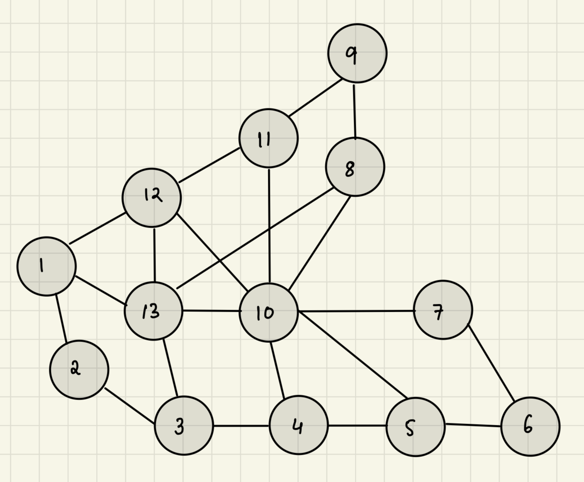
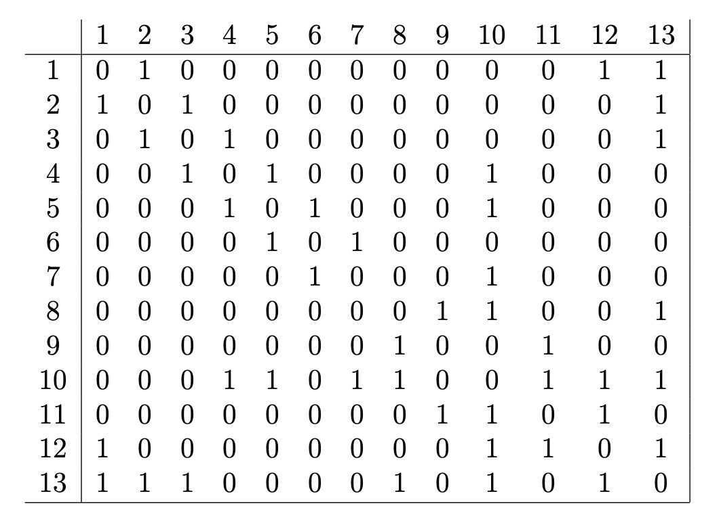
1. Node Link Graph(Hand-drawn on Ipad)
Handdrawn node link graph from the adjancency matrix

Slide 3
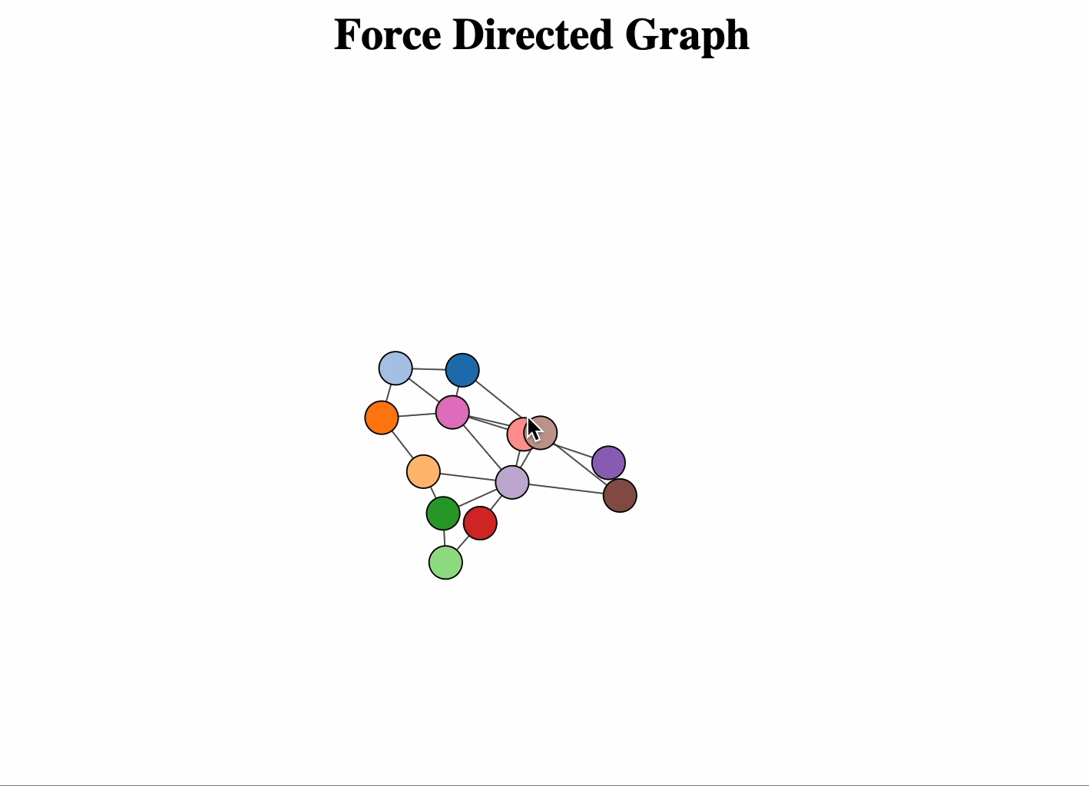
2. Force Directed Layout to visualize the graph
Click this video | Source File: force_directed.html

Slide 4
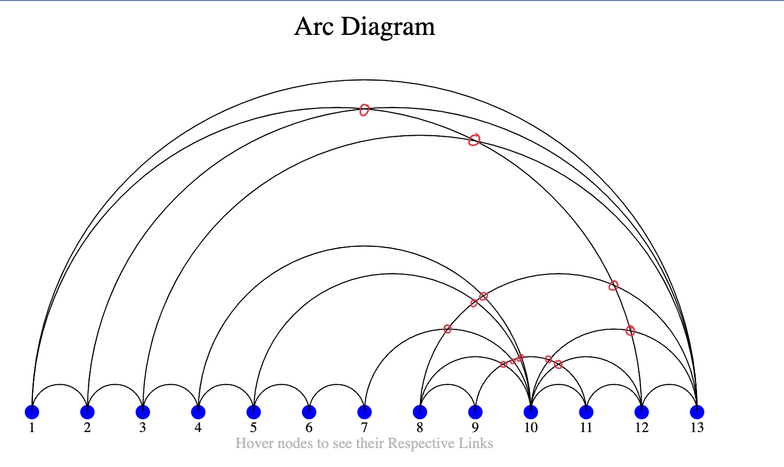
3.Arc Diagram (13 Crossing)
Source File: arc_diagram.html

Slide 5
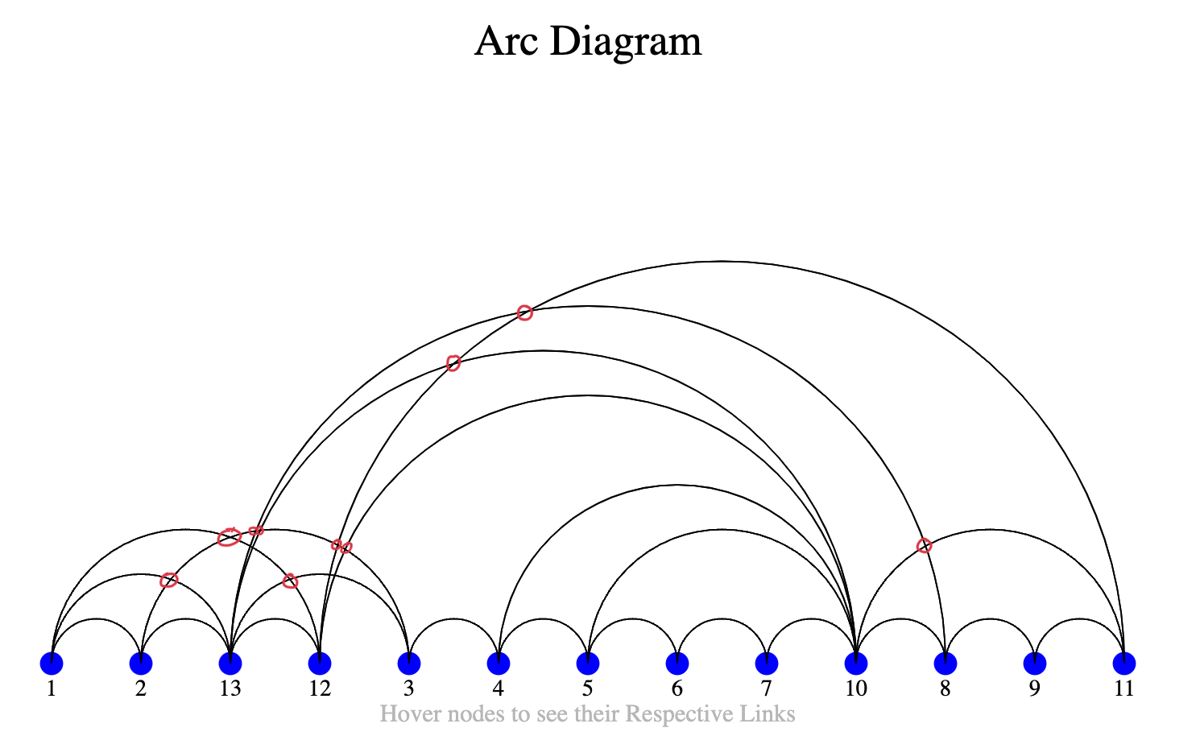
3.Arc Diagram (10 Crossing)
Source File: arc_diagram.html

Slide 6
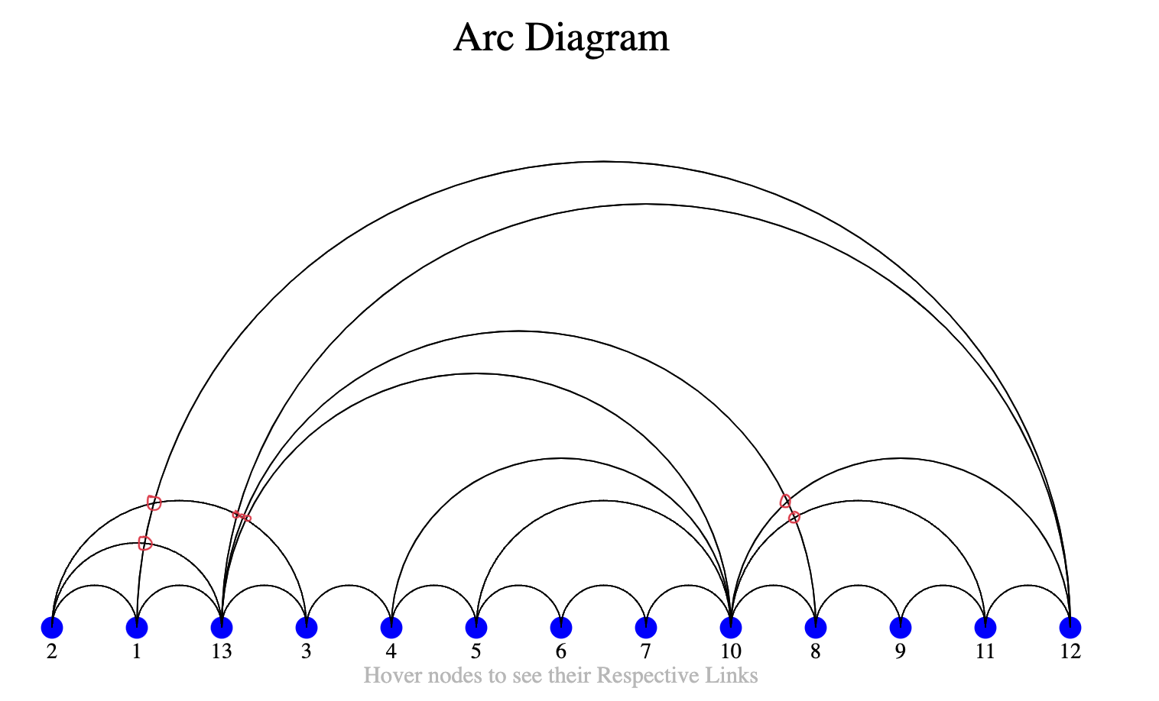
3.Arc Diagram (7 Crossing)
Source File: arc_diagram.html

Slide 7
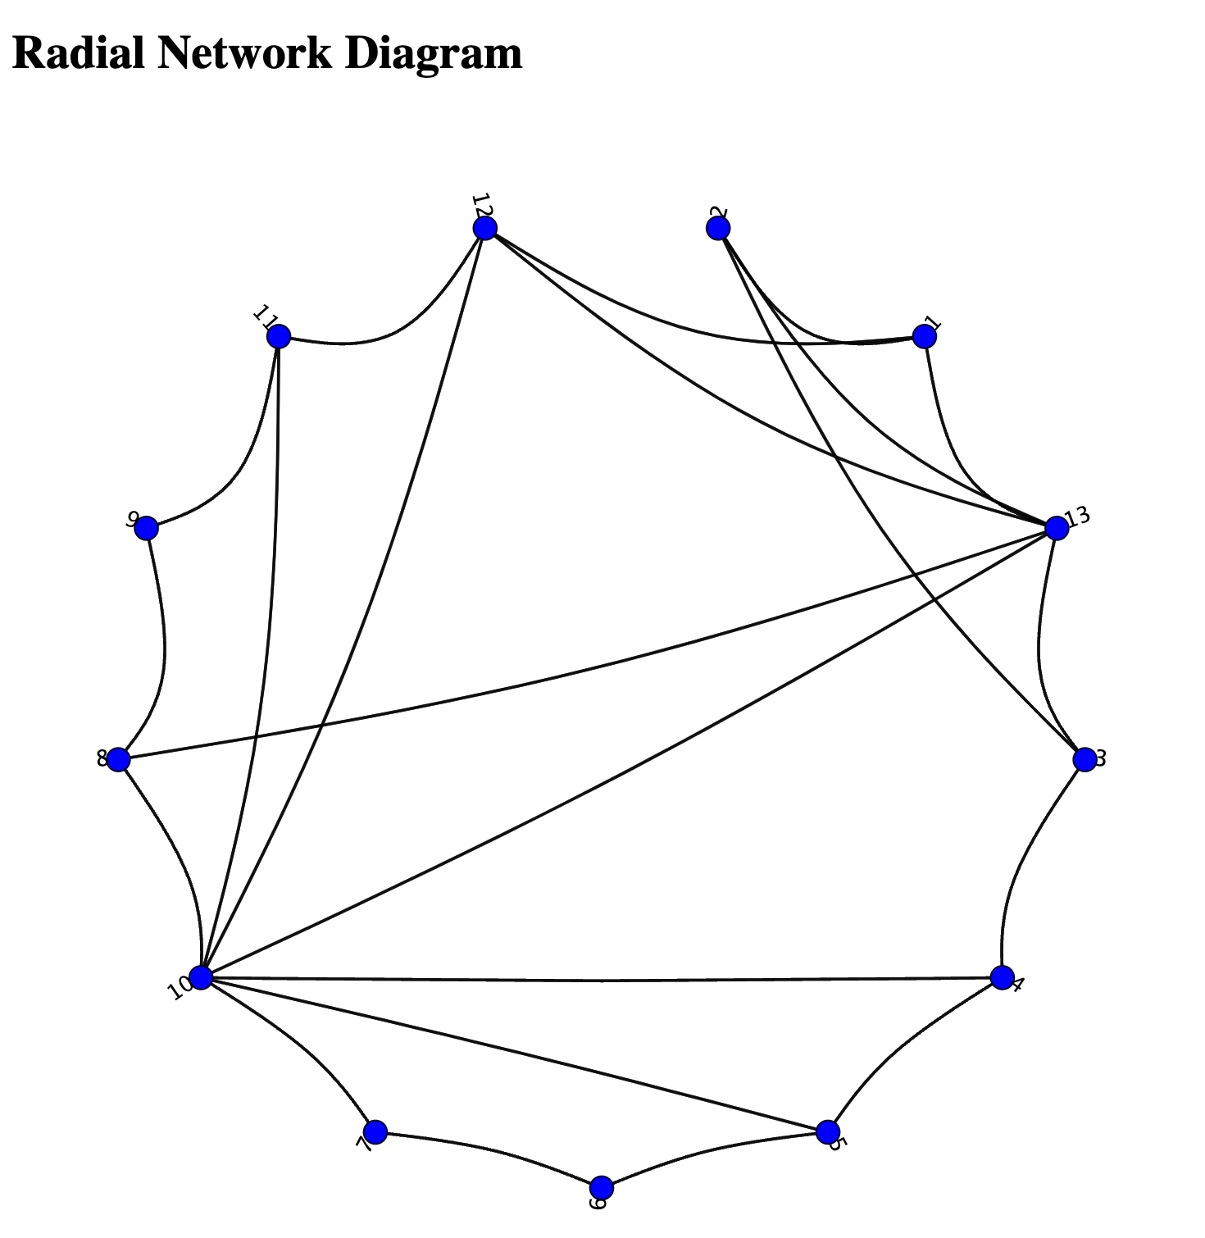
4.Radial Network Diagram using the same last sequence
from the Arc Diagram
Source File: radial_network.html

Slide 8
References
https://www.geeksforgeeks.org/html-center-tag/
https://d3-graph-gallery.com/graph/hierarchical_edge_bundling_basic.html
https://d3-graph-gallery.com/arc.html
https://app.rawgraphs.io/
Files:
Force_directed.html
Arc_diagram.html
Radial_network.html
Data Files
data.json [Used for force_directed.html and arc_diagram.html]
radial_data.json [Used for radial_network.html]

